Slide 1




La Preabilitazione in Chirurgia Bariatrica e le sue Basi Fisiopatologiche
Mirto Foletto, MD
Bariatric Surgery Unit Padova University Hospital

Slide 2
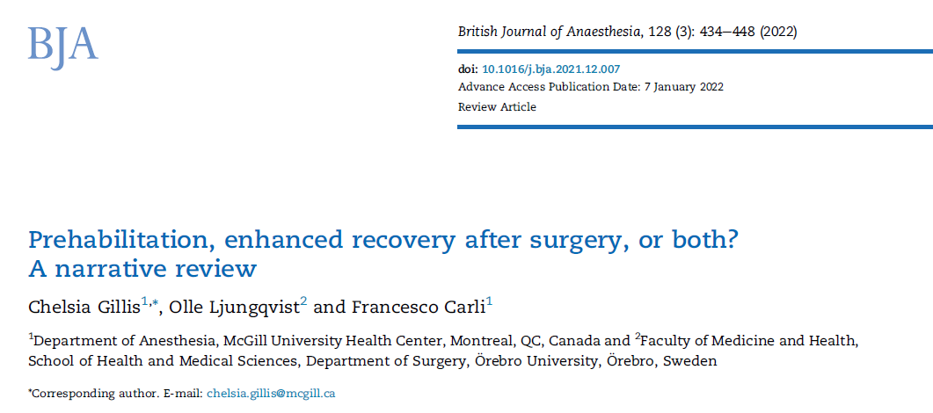
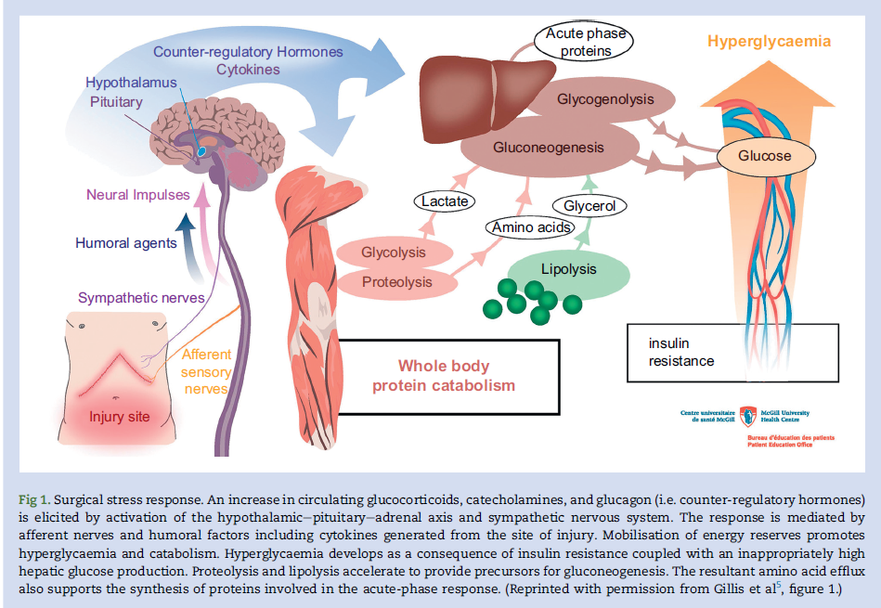
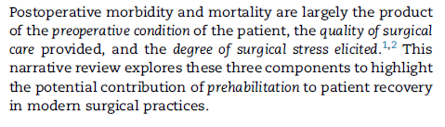

Slide 3
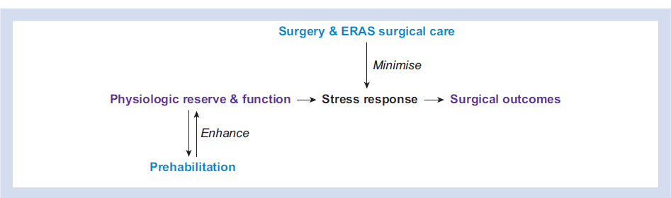

Slide 4
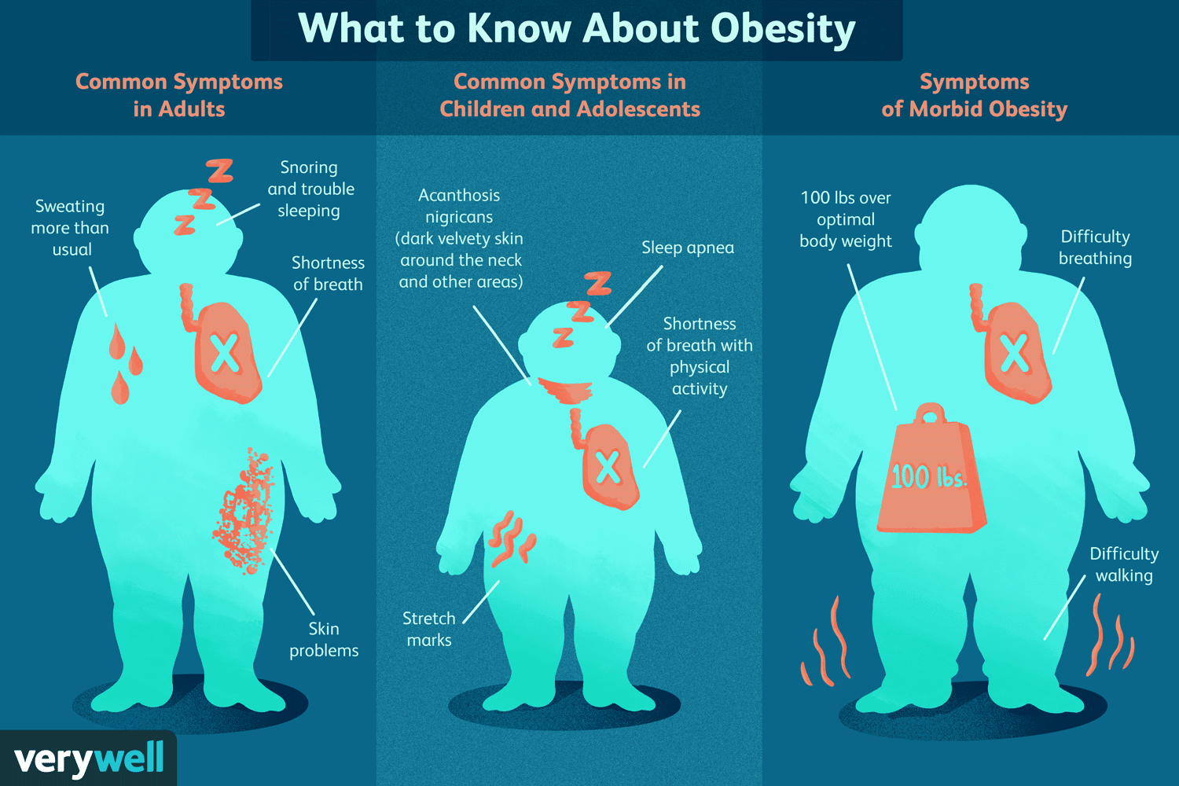
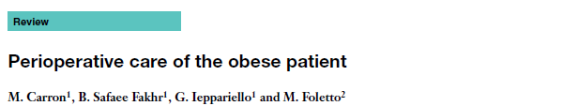

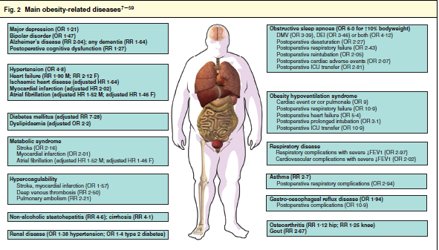

Slide 6
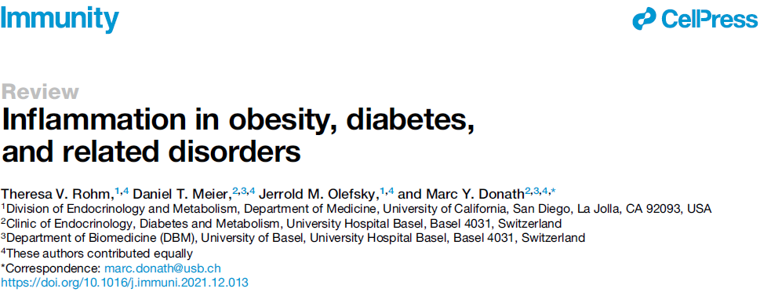
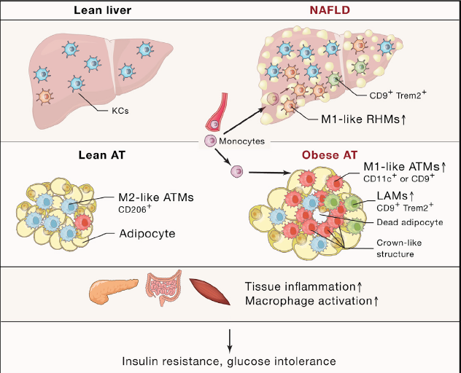

Slide 8
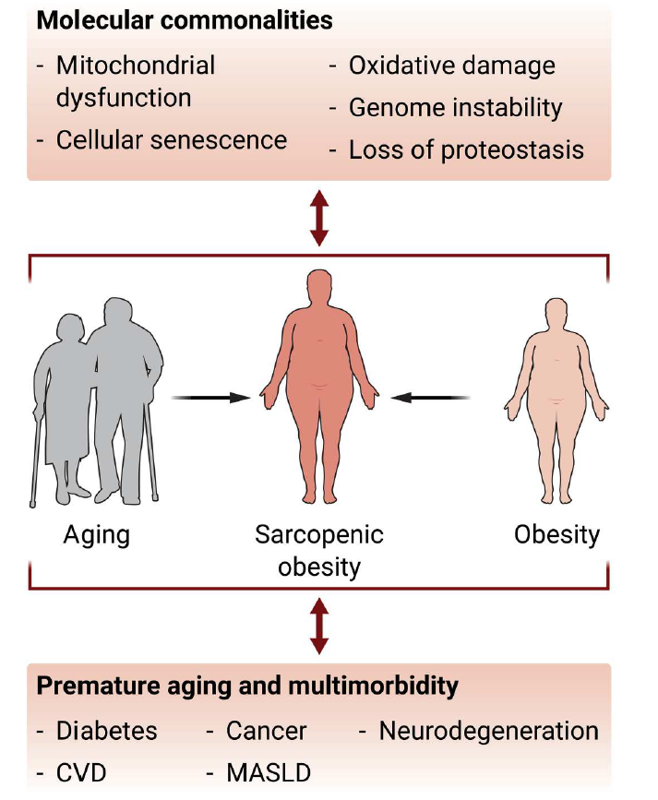
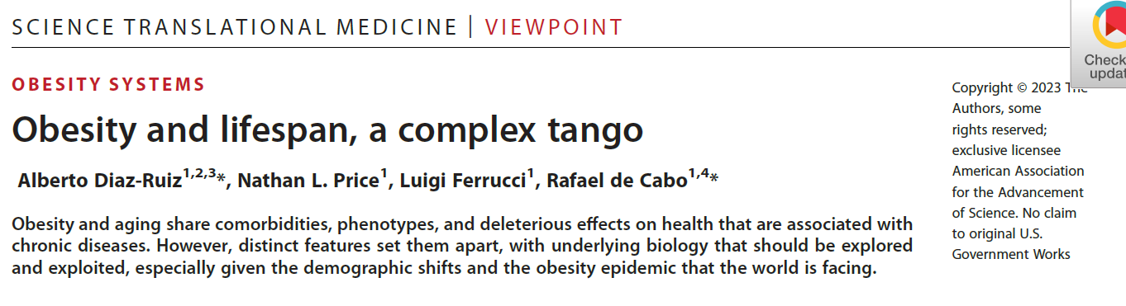

Slide 9

The mission of the Society is to develop peri-operative care and to improve recovery through research, education, audit and implementation of evidence-based practice.

Slide 11
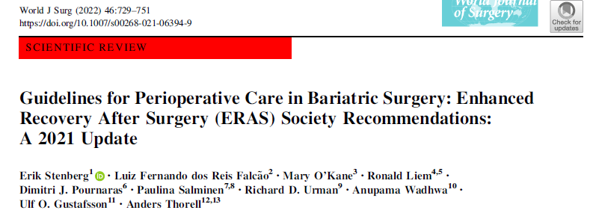
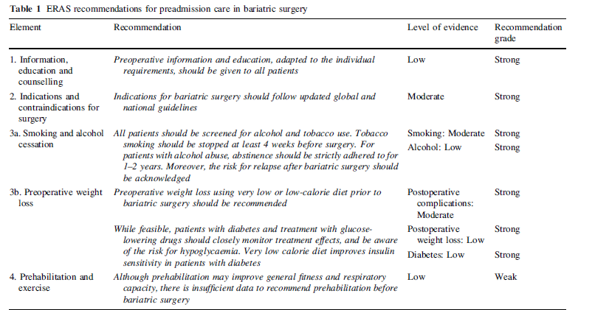

Slide 12
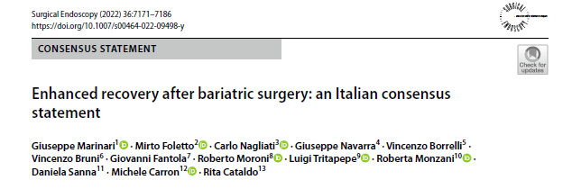
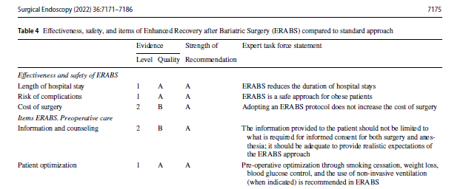

Slide 13

1. Empowerment
2. Compenso metabolico
3. «Funzionalizzazione»

Slide 14


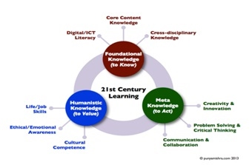
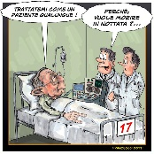
3 major COMPONENTS
Multimodal Approach (EBM)
Interactive and continuous audit
MDT

Slide 15
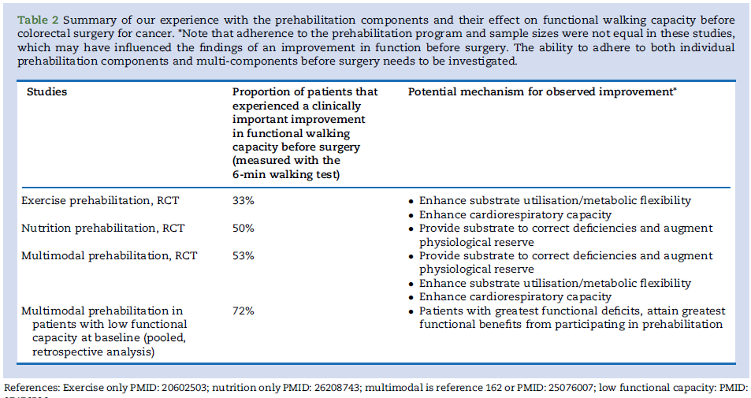

Slide 16
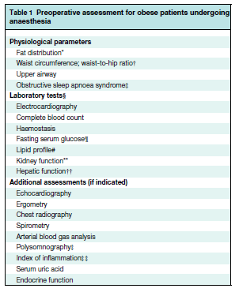

Slide 17
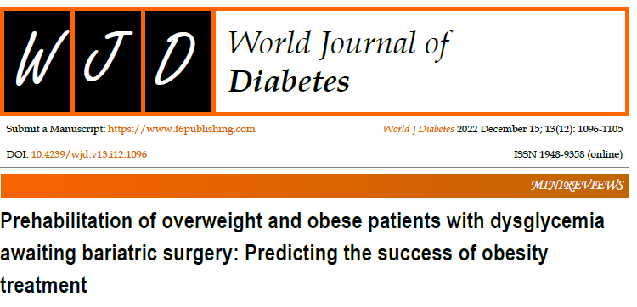
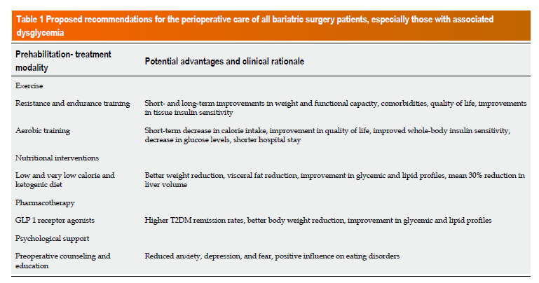

Slide 18
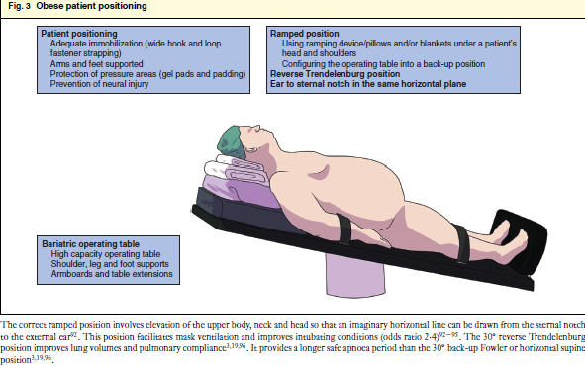
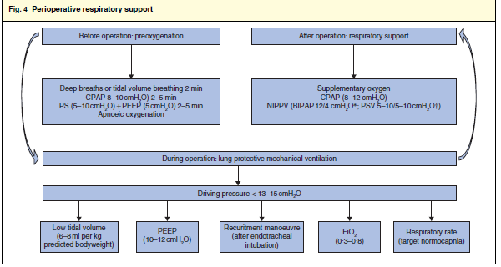

Slide 19
Minimizing pt’s stress response to surgery = quicker recovery and shorter LOS
ERAS ≠ FAST TRACK
QUALITY rather than SPEED

Slide 20

Perioperative care
Operation
outcomes

Slide 21
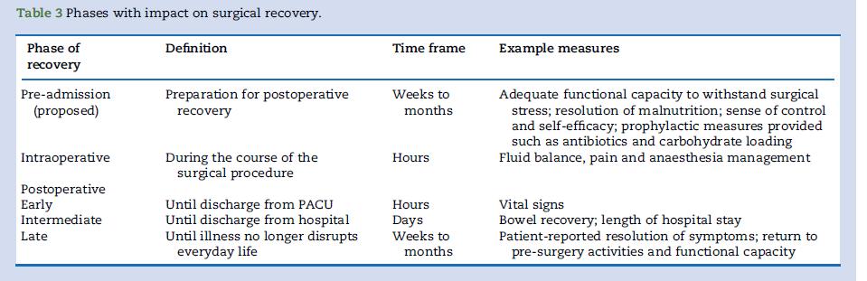

Slide 22

1. Empowerment
2. Compenso metabolico
3. «Funzionalizzazione»
Interdisciplinarietà + multiprofessionalità
Sostenibilità (!?)

Slide 23


